Slide 1
Welcome to the iSchool at Illinois Meg Edwards, Assistant Dean for Student Affairs Dr. Moises Orozco Villicana, Director of Enrollment Management

Slide 2
Growth Across All Programs Led to Fall 2021 Enrollment Record – 1,468
Degree | Growth
BS/IS Degree | +149%
MS/IM Degree | +139%
PhD in IS | +57
MS/LIS (online) | +10%
MS/LIS (on-campus | +2%

Slide 3
Spring 2022 Enrollment – 1,379 New Spring 2022 Record
25% Overall Enrollment Growth
88% Growth, BS/IS
77% Growth, MS/IM

Slide 4
iSCHOOL
GRADUATE DEGREE PROGRAMS
MS in Library and Information Science
40 credit hours / ~ 10 courses
2 required courses
18– 24 months to complete
32 – 34 credits of electives
MS in Information Management
40 credit hours / ~ 10 courses
3 required courses
18 - 24 months to complete
28 credits of electives

Slide 5
iSCHOOL
GRADUATE DEGREE PROGRAMS
CAS in Library and Information Science
40 credit hours / ~ 10 courses
1 required course
1 guided individual project
24 months to complete
PhD in Information Science
48 - 80 credit hours
3 required courses
Completion of dissertation
Up to 5 years of funding

Slide 6
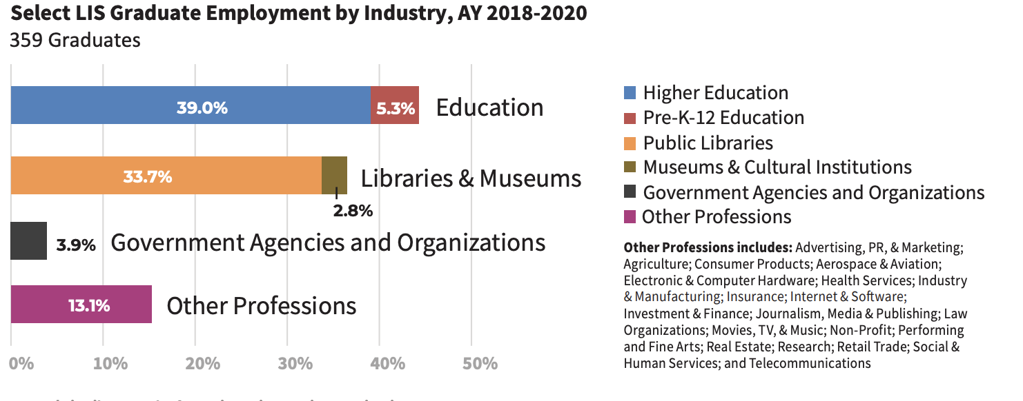
FIRST DESTINATION
MS/LIS

Slide 7
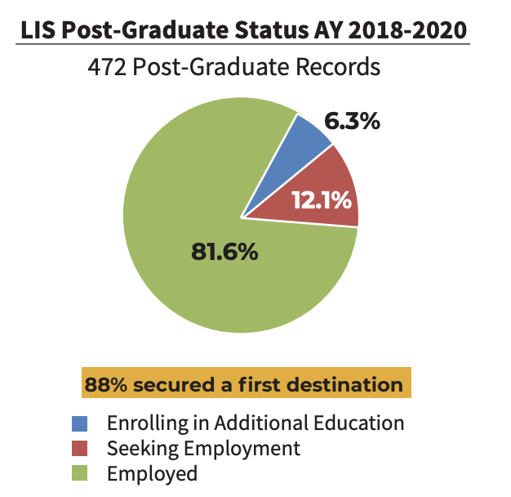
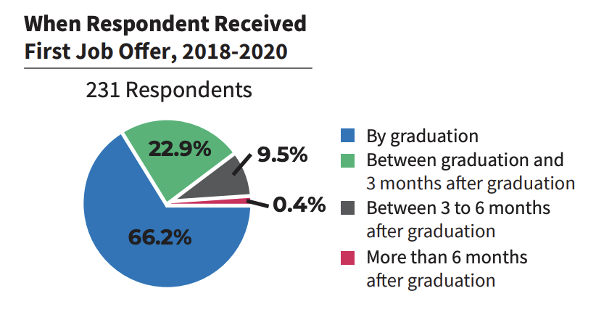
FIRST DESTINATION
MS/LIS

Slide 8
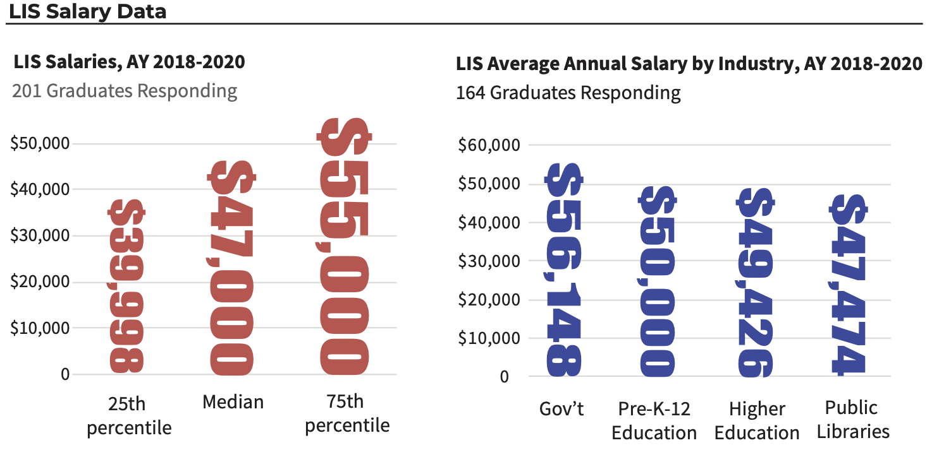
FIRST DESTINATION
MS/LIS

Slide 9
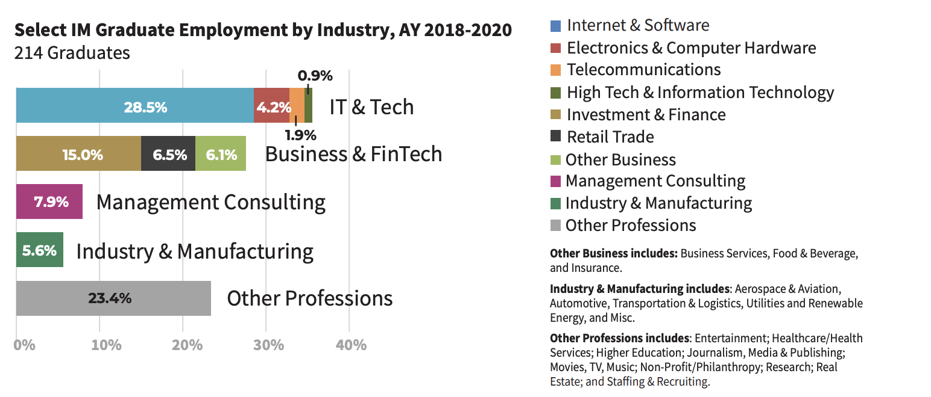
FIRST DESTINATION
MS/IM

Slide 10
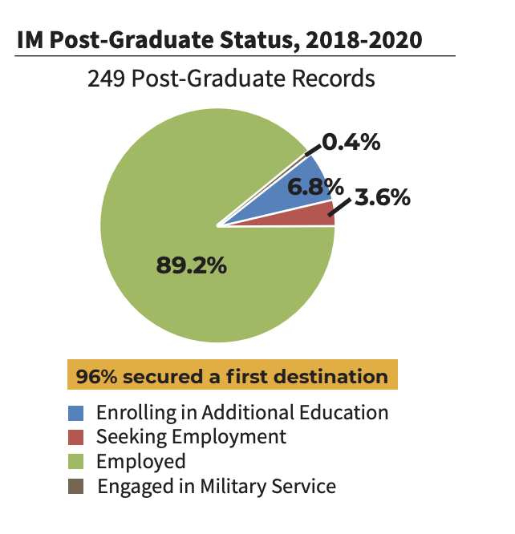
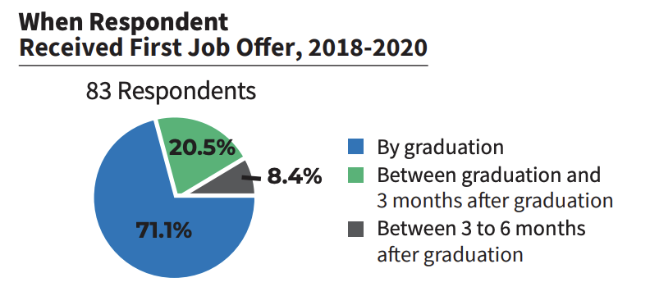
FIRST DESTINATION
MS/IM

Slide 11
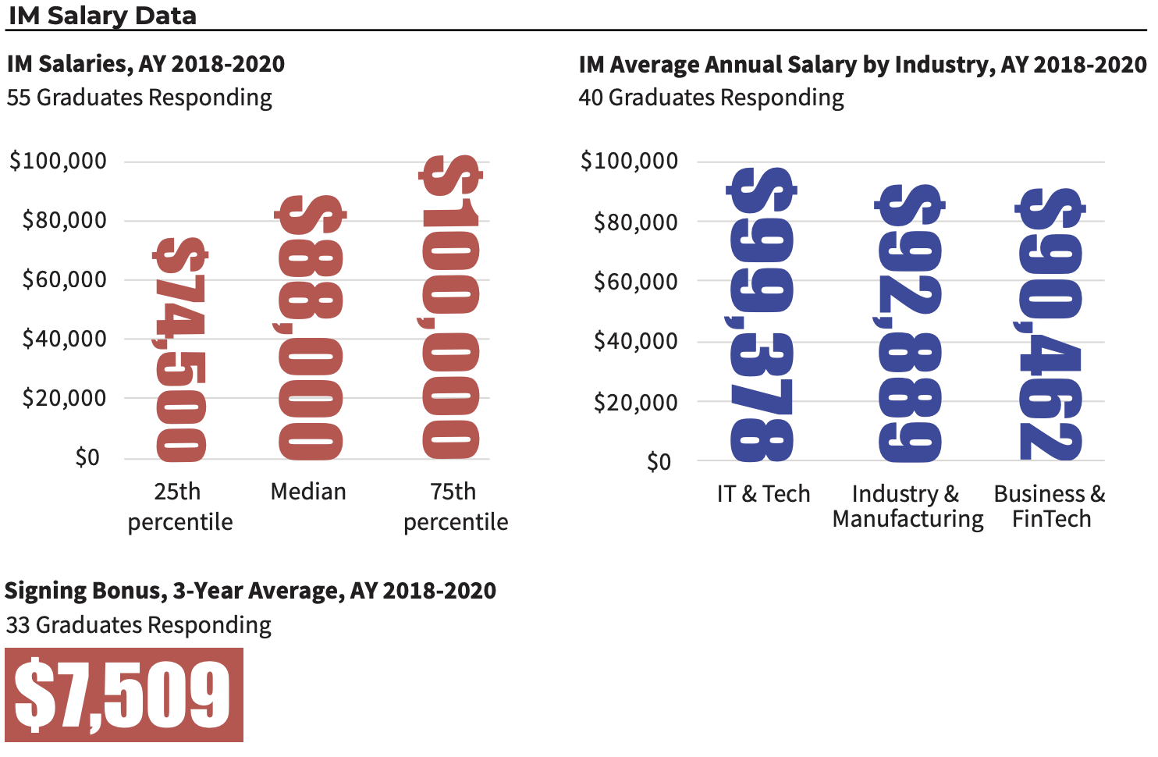
FIRST DESTINATION
MS/IM

Slide 12


STUDENT AFFAIRS
Student Support
ADVISING
CAREER SERVICES

Slide 13


STUDENT AFFAIRS
Student Support
STUDENT LIFE
STUDENT LEADERSHIP

Slide 14
CONFIDENTIAL RESOURCE
CLASS SELECTION
REFERRALS TO UNIVERSITY RESOURCES
iSCHOOL AND UNIVERSITY POLICIES AND PROCEDURES
ADVISING

Slide 15
ONE-ON-ONE RESUME & COVER LETTER REVIEWS
JOB SEARCH STRATEGY
SALARY NEGOTIATIONS
PROFESSIONAL DEVELOPMENT
ALUMNI CAREER PANELS
CAREER SERVICES

Slide 16
STUDENT GROUPS
ACADEMIC AND PROFESSIONAL WORKSHOPS
STUDENT SOCIALS
STUDENT SUPPORT (ACADEMIC FINANCIAL, SOCIAL, ETC.)
STUDENT LIFE

Slide 17
STUDENT GROUP LEADERSHIP
STUDENT REPRESENTATIVES
LEADERSHIP WORKSHOPS
LEADERSHIP ROUNDTABLES
STUDENT LEADERSHIP

Slide 18
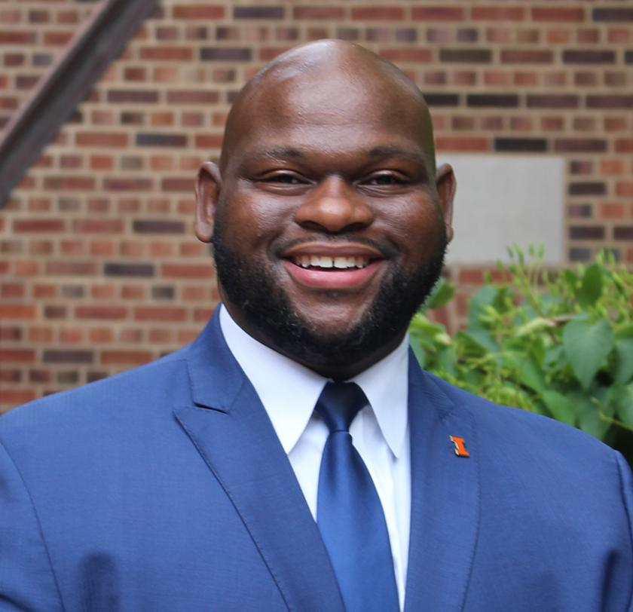
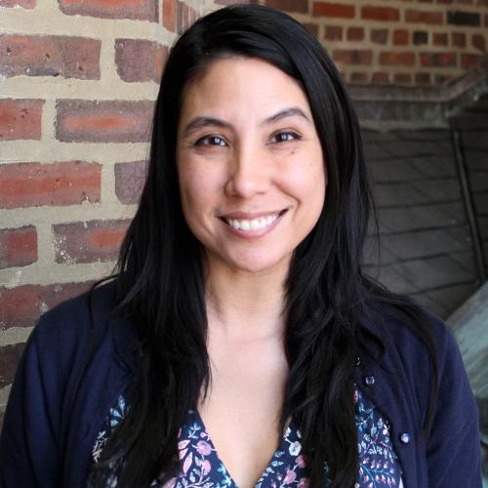
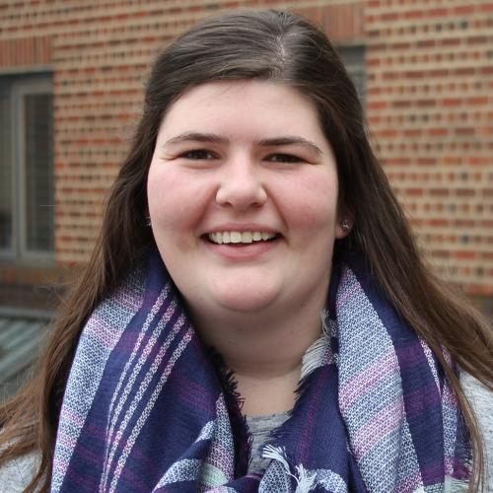
iSchool Graduate Affairs Staff
Denzel Goodloe
Assistant Director of MS/IM Advising
Karla Lucht
Assistant Director for MS/LIS Advising
Katelyn Talbott
Academic Advisor MS/LIS

Slide 19
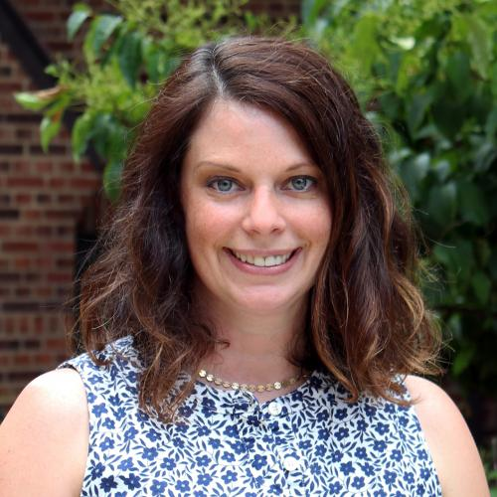
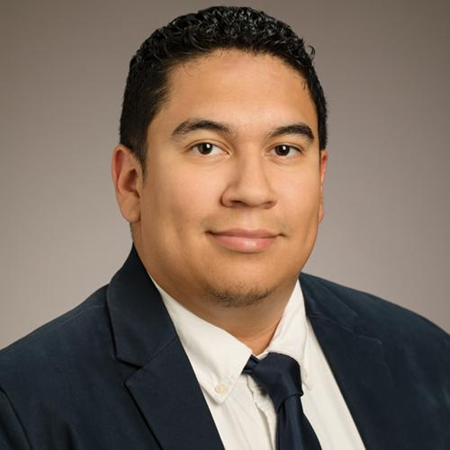
iSchool Undergraduate Affairs Staff
Melissa Newell
Director of Undergraduate Affairs
Tony Torres
Academic Advisor and Coordinator of Undergraduate Affairs

Slide 20
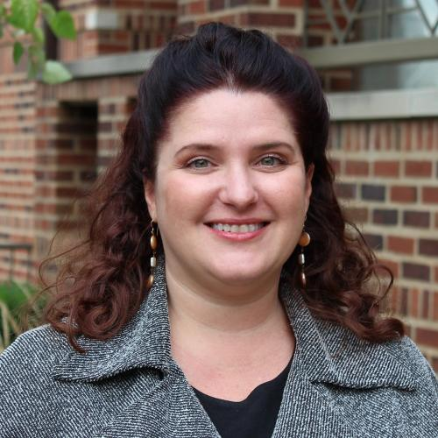
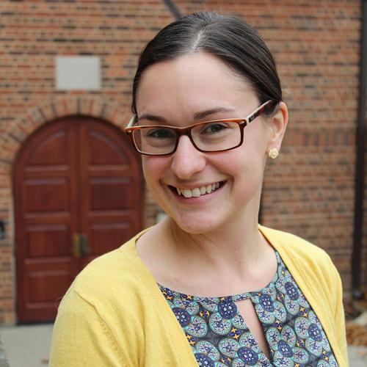
iSchool Career Services Staff
Rebecca Hodson
Assistant Director of Career Services
Michele Plante
Assistant Director or Employer Relations

Slide 21
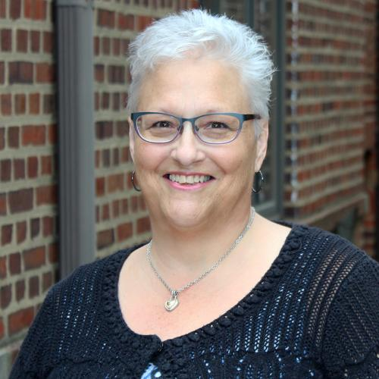
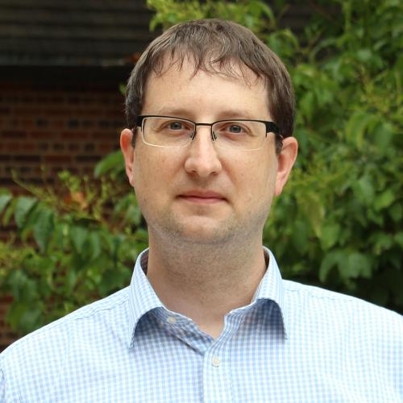
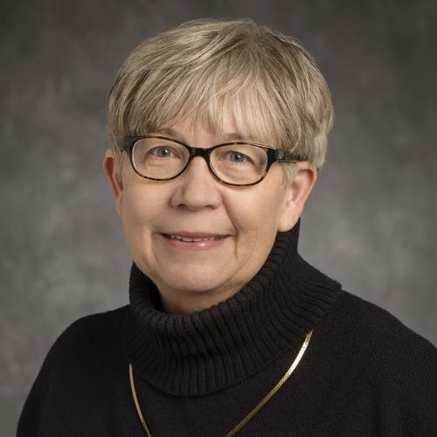
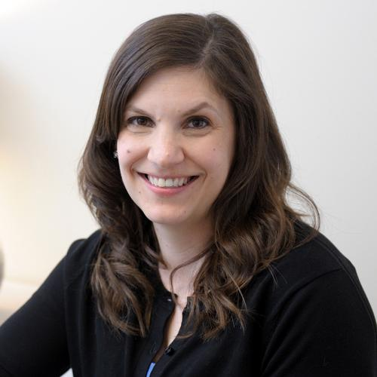
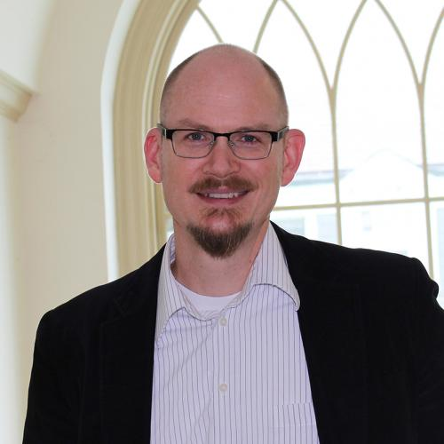
ACADEMIC AFFAIRS
Leads the development of new academic programs and delivery methods
Oversees course and curriculum development in collaboration with Program Directors and program committees.
Represents the School’s academic and teaching efforts within the University and externally.
Includes Student Affairs: Advising, career services, and co-curricular learning for Master’s, Undergraduate, and PhD degrees

Slide 22

Graduate Admissions Overview
Requirements:
Bachelors Degree
GRE or GMAT are optional
Fall 2022 Admissions Cycle:
Application portal opened: August 1, 2021
Final application deadline: January 15, 2022
Decision notification date: March 16, 2022

Slide 23

Application Materials
Graduate College Application
Personal Statement
Resume
Transcripts
3 Letters of Recommendation
English Proficiency Scores
TOEFL
IELTS
Duolingo

Slide 24

International Applicants
International Applicants
$90.00 application fee
Proof of funding documentation
Provide evidence of English proficiency
Must meet minimum requirements based on their country of origin

Slide 25

English Placement Tests
TOEFL: minimum of 104 or higher (at least a 25 in each section)
IELTS: minimum score of 7.5 in each section
Duolingo English Test: minimum score of 105

Slide 26

Personal Prompt
750-1,000 words
12pt. Arial font
Single spaced
Should discuss the applicant's objectives for this degree, including:
How the applicant's educational background, work experience, and other relevant experience will contribute to their experience at the iSchool.
How attending the iSchool will assist the applicant in achieving their goals.

Slide 27


Letters of Recommendation
Written by previous instructors or supervisors
If you completed a degree in four years or less, at least one letter should be from a previous instructor
Speak to your success as a student and your aptitude for success in graduate coursework
Highlight your skills, abilities, passion, and fit in the information professions

Slide 28

Tuition and Funding
Graduate Hourly Positions
Available through the iSchool, University Library, and various units across campus
iSchool Scholarships
Incoming MS/IM students are evaluated through their application for funding for their first semester
Criteria that are considered include merit, need, and diversity
External Funding Opportunities
Financial Aid – Student Loans*
*Available to US citizens only

Slide 29

5 Ways to Standout in the Graduate Application Process
Know Your Self
Do a Deep Dive into Programs of Interest
Create a Compelling and Authentic Narrative
Work Ahead + Ask for feedback
Feature Strengths + Acknowledge Growth Areas/Challenges

Slide 30

Connect with us
Website, ischool.Illinois.edu/visit
Attend a monthly information session
iSchool Ambassadors
One on One virtual meeting
Complete our interest form, https://ischool.illinois.edu/visit/request-information

Slide 31
Contact Information
Meg Edwards, mbedward@Illinois.edu
Moises Orozco Villicana, orozco6@Illinois.edu
is-futurestudents@Illinois.edu
Ischool-apply@Illinois.edu

